Slide 1
Case Studies of (3) Women Leaders in Higher Education (HE) Institutions
Dr. Barbara Cozza cozzab@stjohns.edu
Professor, Chairperson, Director of Administrative and Instructional Leadership
Educational Leadership - Department of Administrative and Instructional Leadership
St. John’s University
This Photo by Unknown Author is licensed under CC BY-SA-NC

Slide 2
Focus of Study Presentation
Conducted multi-case studies of women leaders in three different higher education institutions.
Aim was to gain an in-depth understanding of a phenomenon in its natural setting – search for cross case patterns of overcoming the Women in HE Leadership gender gap
Conducted interviews, observed meetings, and collected artifacts
Sample:
CAO Vice President of Student Service 2 year college
CAO-COO Vice President Admin. &Finance of 4 year University
President 2 year college
Notes:
Studied phenomenon at three different sites.
Made use of qualitative tools and techniques for data collection and analysis
Findings focus on data that answer research questions
Discussion of implications and strategies based on data.

Slide 3
Pipeline Myth
Pipeline myth –
persistent idea that there are too few women qualified (e.g., degree holding) for leadership positions
Pipeline prepares women at an increased rate than it does men
Female students earned half or more of all baccalaureate degrees for the past three decades and of all doctorate degrees for almost a decade

Slide 4
Statistics of Women in Higher Education… Women have
earned more than 50% of PhD or EdD degrees since 2006
earned more than 50% of bachelor’s degrees since 1982
earned more than 50% of master’s degrees since 1987
earned more than 50% of associate degrees since 1978
As of 2015,32% hold full professor lines -
Notes:
Higher the academic rank, fewer women hold these positions.
Women of color often outnumber men of color in lower-ranking faculty position, but men of color hold full professor more often than women of color.
The phrase ‘the higher the fewer’ is used to recognize the fact that even though women have higher education attainment levels than men, this is not reflected in the number of women holding positions with high faculty rank, salary or prestige. Women of all races and ethnicities are more likely to hold lower ranking faculty positions.
In 2015, male faculty held a higher % of tenure positions at every type of institution even though they did not hold the highest number of faculty positions at every rank.

Slide 5
Data on Presidents and Chief Academic Officers (CAOs - VPs)
Women presidents have increased from 1986.
However, as of 2016
70% men presidents
30% women presidents
Notes:
Research data taken from the ACE seminal survey study on this population.
CAO is an important position given the role in setting the academic direction of an institution and the fact that many CAOs aspire to the college presidency.

Slide 6
Data on Presidents in Higher Education
Women currently married 75%
Men currently married
90%
74% Women have children
89% Men have children
16 % of men altered career for dependents
32% of women altered career for dependents
Notes:
Women presidents are less likely to be married, less likely to have children, and more likely to have altered their career to care for spouse/partner, child, or parent.

Slide 7
FACTS of Women Presidents
More likely to have a PhD or EdD than male peers
Three top fields of study for presidents – Education, Humanities, Social Sciences
Women presidents more likely to have served as CAOs/Provosts.
Male presidents more likely to come from outside or had a senior campus executive role

Slide 8
Trend of Chief Academic Officers (CAOs - VPs)
2008
Women serving in CAO position 33.3%
In all doctoral degree institutions
Declined
2013 women CAOs 26.1%
Notes:
In public slightly higher – 25.3% 2013 and 40.0% in 2008 - Private 25.9% 2008 and 27.9% 2013
Family information: Married 88.50% men – 70.70% women Have children 87.30% men - women% 73.10
Men CAOs slightly lead women CAOs on possessing a doctorate – unlike presidencies.

Slide 9
What does Literature say on Women Leadership?
Leadership/Style – subjectively constructed
Process in which an individual influences a group of individuals to achieve a common goal (Northhouse, 2004)
Bring significant and lasting changes in heterogeneous group (Gardener, 1995)
Leadership Style has two dimensions:
Goal setting, organization, direction, control
Relationship involving support, communication, interaction, active listening (Hersey & Blachard, 1988)
Notes:
A precise definition of the ideal leader would be useless considering the numerous factors that might shape such a style based on environment.

Slide 10
Gender and Leadership
Two opposite currents need to be adopted in the workplace.
Develop behaviors that do not deviate from female role expectations but masculine enough to gain credibility as a professional
Masculinity
Task oriented style
Femininity Relationship oriented style
Notes:
The relationship between gender role and leadership is associated to masculinity with task-oriented leadership styles and femininity with relationship-oriented one (Oshagbemi & Gill, 2003).
Two opposite currents are constantly encountering women swimming in the middle when they have to decide what leadership styles need to be adopted in the workplace. Jamieson (1995) developed the concept of the femininity/competency bind – feminine associated to incompetence and masculine associates with competency. Masculine model represent the universal and dominant model of leadership (Fernandes & Cabral-Cardoso, 2003). Women understand that in order to escalate the ranks they have to conform to it (Rigg & Sparrow, 1994).
Gender role: distinctive culturally created qualities of men and women apart from biological differences (Brandser, 1996). The construct of gender implies the way meaning associates with sex in members of a culture in terms of expected learned behaviors, traits, and attitudes (Northouse, 2004). The concept of gender role is situationally constructed in organizations, and based on : masculinity involving aggression, independence, objectivity, logic, analysis, and decision, and; femininity involving emotions, sensitivity, expressiveness, and intuition (Fernandes & Cabral-Cardoso, 2003).

Slide 11
Today the Role of the Women Leader
The role
Transcend the traditional notion to Instructional leader
No longer manager (i.e. making decisions about how things should be done to sustain organizational efficiency)
Today, 21st Century Instructional Leader Sets Goals (i.e. contribute heavily to school improvement restricting or re-culturing and school effectiveness – instructional leadership, discipline, supervision, fundraising, public relations, student improvement and fiscal management – more accountability
Notes:
Socialization - Knowledge, skills and dispositions needed to perform a social role (or social behavior) woman as nurturer, caring roles are supportive roles not leading roles – becomes a barrier
Culture – women can only practice leadership values up to a point – woman always aspires to be as good as a man – no point trying to be as good as a woman
Organizational Culture – someone appointed from inside brings past experience and knowledge to the process for the work setting, policies and organization procedures – women bring more authentic and less accommodative styles.

Slide 12
Trends of Women Leaders in Higher Education
Women tend to be transformational leaders
Focus on care of students and their academic success
Building relationships with others to achieve common goals – women value close relationships with colleagues, staff, parents, community and board members
Leadership style is more democratic, sharing, inclusive and collaborative
Vision is through shared decision-making, problem solving to find the solution of the problem for the general good. Decisions are based on what is in the best interest of the students, what is right, and not necessarily on policies and power (value influence).

Slide 13
Female Leadership – Interactive leadership (Rosener, 1990)
Encourage participation;
Share power and information;
Enhance self-worth;
Change self interests for an overall good;
Relate power to interpersonal skills; and
Believe in better performance when feeling good

Slide 14
Why the GENDER GAP in Higher Education? Potential Sources of the Problem
Role Models and Mentor
Leadership Stereotypes
Pipeline for Higher Education Leaders
Work-life Balance
Reasons for Entering Higher Education
Personal Wherewithal
Supportive Environment
This Photo by Unknown Author is licensed under CC BY-NC-ND
Notes:
Role Models and Mentor- there are few female role models in HE administration. Role models tend to be males
Leadership Stereotypes – characteristics of women leaders are not associated with strong leadership ability and women are not pushed to pursue leadership positions
Pipeline for Higher Education Leaders – no systematic a way to train exceptional staff for leaders to encourage more diversity in leadership roles
Work-life Balance – women are less willing to make sacrifices required for leaders than their male counterparts (i.e. leave for children, parent responsibilities)
Reasons for Entering Higher Education- usually satisfied with staying as professor and not looking for leadership roles
Personal Wherewithal – persistence, education, talent and time are important qualities (women hold these)
Supportive Environment – having support from family is important for women to succeed as leaders

Slide 15
The Research Study/Questions
Research Questions:
How has the woman leader successfully achieved the leadership position in the higher education organization, despite the odds relating to the gender gap?
What discourses (conversations) are employed to shape the woman leadership position?
Which style of leadership characterizes the woman leader’s role?
Notes:
To explore the source of the problem and derive possible solutions, I conducted Multiple Case Study Research with women higher education leaders to see why they believe there is a gender gap, why they were able to succeed, and how to address the gap

Slide 16
Research Procedures – Triangulation of Data
Research Assistant and myself visited each sample population at each campus.
Interview: We interviewed the candidate using open-ended interview questions based on three phase process (Speidman, 2013). Phase I Background; Phase II Context; Phase III Reflection
Observation: Then, we observed a cabinet meeting with members of the cabinet that are supervised under the candidate.
Artifact: Finally, each candidate submitted an artifact that represented her leadership style in some way.
Notes:
Artifact
Each participant selects at least one artifact that shows an accomplishment that was attained from the outcome of being a woman leader in higher education.
Observation
Each participant was observed by the researcher in a professional leadership situation such as a presentation at a meeting, that was selected by the participant. The researcher took field notes during the observation of the event and coded the data for analysis.
Interview (Speidman, 2013 process)
a. The interview process was conducted in three phases Phase I: Participant’s prior experiences with the topic will be discussed; Phase 2: Participant’s current experiences with the topic; and Phase 3: Participant reflects on the role of a woman in leadership in a higher education position.
b. The sessions were audio-taped, transcribed, and field notes were taken.

Slide 17
Multi-case Study Women Leader Samples in NY, CT, NJ
Case Study #1-
Woman in her late 40s is the Vice President of a 2-year Community College in New York. (NY)
Case Study #2
Woman in her early 60s is the Vice President of a 4-year university (CT)
Case Study #3
Woman in her mid 60s is the President of a 2-year Community College (NJ)

Slide 18
Data Analysis – Coded Data
Analysis
Why the Gender Gap in Higher Education?
Potential sources – coded data to see if these women overcame the Gender Gap concerns, and if so, how, they did it
Feminine Leadership Styles – the trends that influence these women HE leaders
Notes:
How has the woman leader successfully achieved the leadership position in the higher education organization, despite the odds relating to the gender gap?
What discourses are employed to shape the woman leadership position? Which style of leadership characterizes the woman leader’s role?

Slide 19
Findings – Participants had mentors – mostly male
How has the woman leader successfully achieved the leadership position in the HE organization, despite the odds relating to the gender gap?
Case Study #1 Had male mentors – “I started my engineering career as faculty member with a male chairperson. He encouraged me to move to leadership.” She was encouraged to pursue EdD by a male leader in the community because “ the Board would like to hire her as president if she has a doctorate degree.”
Case Study #2 “My father influenced me as we argued to how to run a family business.” Also, “I work well with the male Provost by supporting his ideas, for the good of the university.”
Case Study #3 “Basketball coach, Mary Tyler More, 100 yr. old mother, and a male president that scanned me for president because I am bossy.”

Slide 20
Findings - Data shows that all case study participants have different work-life balance:
How has the woman leader successfully achieved the leadership position in the higher education organization, despite the odds relating to the gender gap?
Case Study #1 single, no children (rumors about why she is not married) She has 20,000 children to take care of 24/7
Case Study #2 Supportive spouse – gave her time to work – children are now grown
Case Study #3 Gay, no children – single career woman

Slide 21
Findings – Data from Observations of Meetings and interviews
What discourses (conversations) are employed to shape the woman leadership position? Pipeline Training to identify exceptional leaders
Case Study #1 Moved from faculty to administration. During her move she saw that her work was recognized by males so she kept going. She mentors women ongoing.
Case Study #2 She cultivates women in pipeline because she moved up from work study to trained controller and budget director. Concerned about not following Academic line.
Case Study #3 She selects an outstanding staff member female or male and mentors staff by giving support so that staff member may move up the ladder. Look to males – did what they did to please and then take interactive leader role.

Slide 22
Example Interview Questions
Phase 1 Background:
Why did you choose leadership in HE?
What are your past experiences that lead to this leadership position?
Talk about role models that influenced your decision to become a leader.
Phase 2 Context:
How might you describe your leadership role?
What obstacles do you have a work-family life balance?
Phase 3 Reflect:
What examples can you suggest for improving the woman leader role?

Slide 23
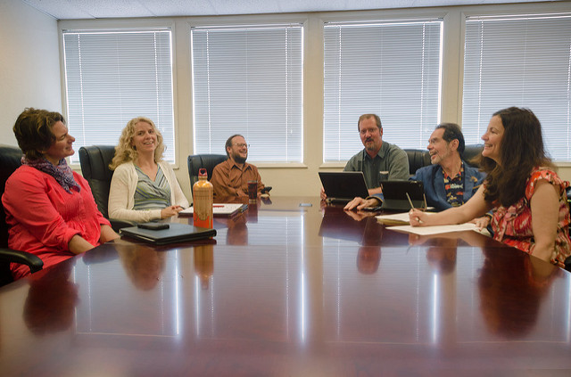
Findings - Interviews and Observations at meetings - Style of Women Leaders
Which style of leadership characterizes the woman leader’s role?
Style does not align with male leader characteristics
Case Study #1
Interview Question: How might you describe your leadership role in the HE organization?
“I do not hire women because of sex – I hired a woman curriculum director for expertise” I am near the current president that uses top down to direct managers. I use a Shared Leadership model and I am not a micro manager.”
Observation: This leader has a relaxed collaborative relationship with all directors during the meeting. She asks questions rather than dictate information to staff during meeting. For example, the directors problem solve on how to set up Orientation Software. Directors were asked to think about which modules to use first.
This Photo by Unknown Author is licensed under CC BY-NC-ND

Slide 24
Findings - Interviews and Observations at meetings - Style of Women Leaders
Which style of leadership characterizes the woman leader’s role?
Case Study #2
Interview Question: How might you describe your leadership role in the HE organization?
“Distribute –share and support by delegating jobs to give responsibility to those that have the expertise. If someone is struggling I take back the responsibility. Some know more than I do, so I let them take charge.”
Observation: She has an informal agenda, but sometimes specific topics to discuss. She conducts meeting to touch base on how things are going. The meeting is to encourage cross communication rather than always going through her as leader and then pass information to others.

Slide 25
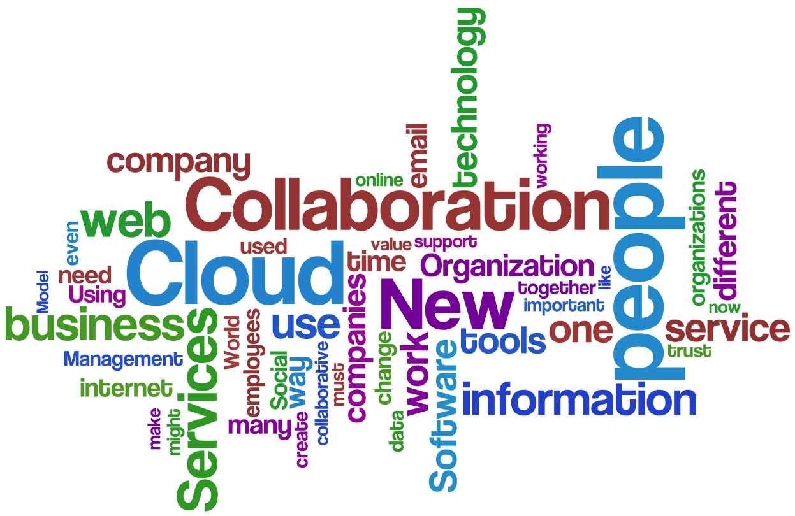
Findings - Interviews and Observations at meetings - Style of Women Leaders
Which style of leadership characterizes the woman leader’s role?
Case Study #3
Interview Question: How might you describe your leadership role in the HE organization?
“Expectations of a women leader is to behave a certain male way such as strong and controlling all situations. But, I need to be kind and assertive and not aggressive. I set goals for helping my students. It is your tone.”
Observation: She has a staff meeting every Tuesday morning with Vice Presidents. It is a PLC to improve communication with all staff members. She wants her VPs to talk and stay connected as she facilitates the meeting and asks questions to drive their thinking about issues. They problem solve.
This Photo by Unknown Author is licensed under CC BY-NC-ND

Slide 26
Findings – How they overcame Barriers/ obstacles/Personal Wherewithal? Artifacts, Interviews
Case Study #1 To overcome barriers (artifact) joined women’s faculty association to stay involved with women on campus. She writes articles on women HE leadership to stay involved. She is known for her international operations and collaborations In DC. Will chair International Consortium college for International Studies in the coming years to integrate international students and involved with the Division of Commerce to keep connections with the local community.
Case Study #2 She is concerned that she might not be able to move to president position because she did not come through academic line. Does not feel she is treated the same as males. Men are not compassionate about family matters (mother ill). She keeps moving on trying to understand culture.
Case Study #3 She decided to become a leader because as a faculty member she was supervised by idiots. She wanted to make changes. She is not treated equal to men – but, she does male things to overcome – play golf, drink wine, follow what men do to compete. She sets goals – retention and graduation rate

Slide 27
Artifacts – announcement for women meetings, goals/trends, responsibilities

Slide 28
Conclusions – Trends that influence women in HE leadership
Changes are being made:
No longer are women imitators of male characteristics – more interactive
These women are recognized for their own feminine styles
Collaborative, encouraging participation, sharing power, setting goals, overcoming barriers by changing self interest for an overall good for the HE organization, acquiring feminine leader qualities of assertiveness, problem solving with others to find solutions, empowering other women, and community building
These woman leaders are willing to be mentors to other women that have exceptional skills to move to leadership roles
These women are transformational leaders that share leadership, collaborate and communicate ideas on all levels.

Slide 29
What should women do? Strategies to close the gender gap…
Strategy #1 create a mentorship program and have a woman leader guide other potential women leaders much like a professional development program
Strategy #2 develop women leadership training opportunities to fix imbalance of leadership preparation
Strategy #3 Make sure you have a support system to help with family
Strategy #4 Connect the pipeline between faculty and administration
Strategy #5 Learn from women successes to help find solutions to encourage women leadership

Slide 30
Implications
Women Leadership should:
Develop behaviors feminine enough to deviate from the male gender role
But, also use male leadership ideas to gain credibility as professionals
Learn from the women who have been able to persevere despite odds – problems are not permanent
Continue to support women to become leaders by offering professional development
Support a more interactive leadership role that encourages communication, collaboration, problem solving, shared leadership

Slide 31
Thanks – keep in touch cozzab@stjohns.edu
Have conversations
Create Professional Development
Write journal articles
Collaborate on women leader ideas
Design a model program for potential women leaders

